Slide 1
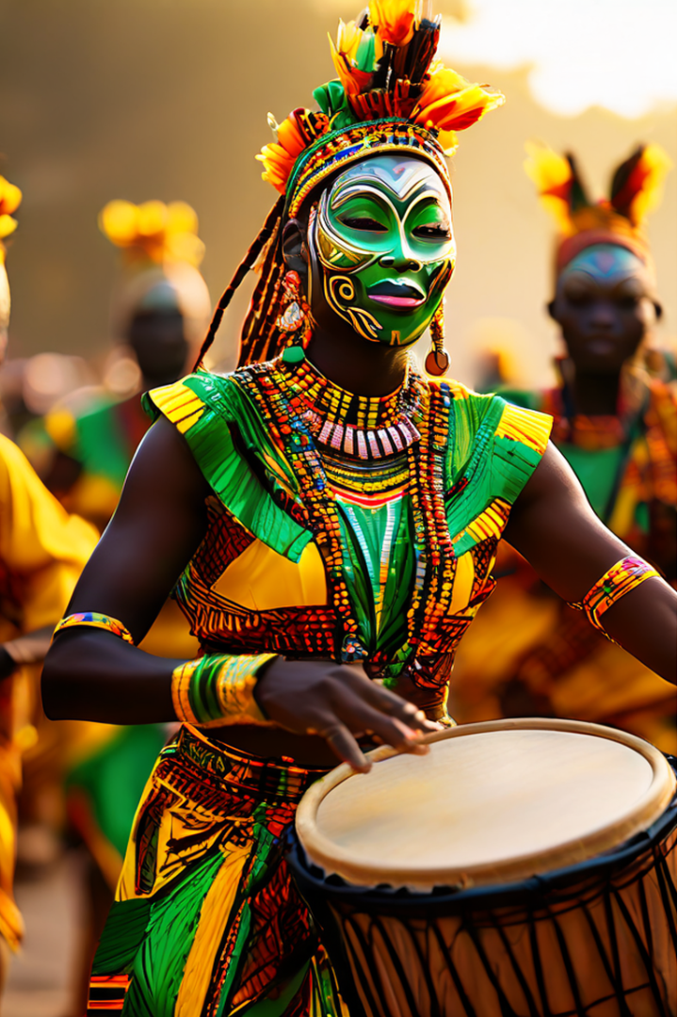
The Richness of African Music and Dance
African culture is a tapestry of diverse traditions, languages, and artistic expressions. At the heart of this tapestry are the powerful and captivating realms of music and dance, which play a vital role in community cohesion, cultural preservation, and social expression. This presentation will delve into the significance of these art forms and explore the evolving landscape of gender roles in African society.

Slide 2
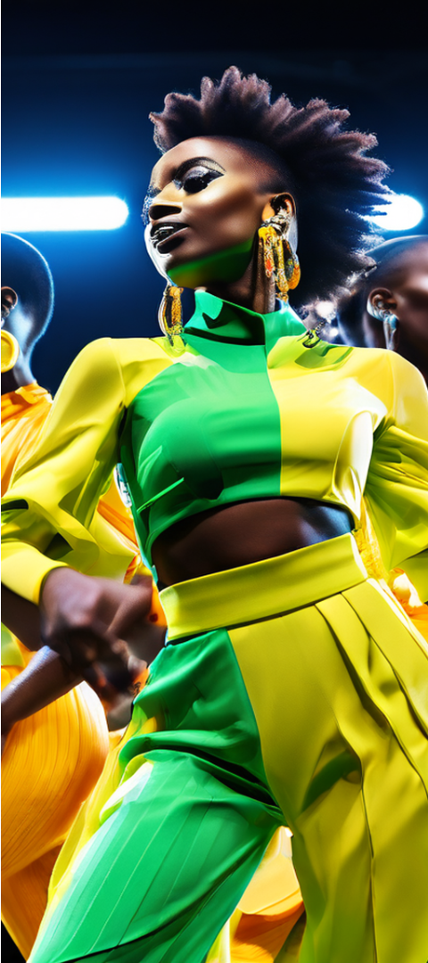
Music and Dance as Cornerstones of African Culture
1
Community Cohesion
Music and dance are integral to African communities, serving as the glue that binds people together. From joyous festivals to solemn rituals, these art forms create a sense of unity and belonging, fostering a deep connection among the members of the community.
2
Cultural Preservation
Through the oral traditions, storytelling, and the passing down of history, music and dance become powerful tools for preserving the rich cultural heritage of Africa. These art forms serve as vessels for the transmission of values, customs, and collective memories from one generation to the next.
3
Social Expression
Music and dance provide a vibrant platform for African communities to express their collective sentiments, emotions, and social issues. Whether in celebratory, mourning, or protest contexts, these art forms become a means of communication, reflecting the heartbeat of the community.

Slide 3
Exploring the Griot Tradition in West Africa
The Role of Griots
The Griot Dance
Cultural Significance
Griots are traditional storytellers, musicians, and historians in West Africa. They play a crucial role in preserving the cultural heritage and passing down the narratives of their communities through intricate performances of music and dance.
The Griot dance is a captivating performance that combines storytelling, music, and movement. Griots use this dance to recount the histories, customs, and values of their people, weaving a tapestry of cultural knowledge and identity.
The Griot dance is performed during significant events, such as weddings, funerals, and community gatherings. These performances reinforce the cultural values, traditions, and collective memories of the West African communities, ensuring the continuity of their rich heritage.

Slide 4
Evolving Gender Roles in African Society
1
Shifting Perspectives
2
Empowering Women
Gender roles in traditional African societies have historically been defined by cultural norms and expectations. However, these perspectives are evolving, as women are increasingly participating in education, employment, and leadership roles, challenging long-held assumptions.
The advancement of women's rights and the promotion of gender equality have had a profound impact on cultural and societal development in Africa. Improved access to education and economic opportunities for women have led to enhanced social stability and economic growth.
3
Contributions to Music and Dance
4
Ongoing Challenges
Despite the progress made, there are still barriers to achieving true gender equality in African societies. Cultural resistance, economic disparities, and legal issues continue to pose challenges in the pursuit of a more equitable and inclusive future.
African women have made significant contributions to the realm of music and dance, using these art forms to entertain, educate, and raise awareness about social issues and women's rights. Artists like Miriam Makeba and Angélique Kidjo have become trailblazers in this regard.

Slide 5
The Power of Gender Awareness in African Society
Understanding Gender Roles
Promoting Gender Equality
Exploring the evolving gender roles in African societies is essential for appreciating the rich tapestry of cultural dynamics. This understanding helps us recognize the contributions of women and the progress being made towards greater equality.
Various initiatives and programs, both governmental and grassroots, are working to promote gender awareness and equality in Africa. These efforts aim to dismantle cultural barriers, address economic disparities, and create a more inclusive and equitable future.
Positive Societal Impact
The Role of African Women
Gender equality has a transformative impact on cultural and societal development in Africa. When women have access to education, economic opportunities, and leadership roles, communities experience enhanced social stability, economic growth, and improved overall well-being.
African women have been at the forefront of the fight for gender equality, using their voices and talents to advocate for their rights and challenge traditional norms. Their contributions to music, dance, and social movements have been instrumental in driving cultural and societal change.

Slide 6




Music and Dance as Agents of Social Change
Amplifying Voices
Challenging Norms
Fostering Unity
Music and dance provide a powerful platform for African communities to amplify their voices, express their concerns, and advocate for social change. These art forms become powerful tools for mobilization and activism.
Through their creative expressions, African artists, particularly women, are challenging traditional gender roles and societal norms. Their performances become a means of disrupting the status quo and driving progress towards greater equality.
The collective experience of music and dance can bring communities together, fostering a sense of unity and solidarity. This unity can then be harnessed to collectively advocate for social, cultural, and political change.

Slide 7





The Intersectionality of African Music, Dance, and Gender
Musical Empowerment
Embodying Change
Community Empowerment
Advancing Equality
African music has long been a medium for self-expression, particularly for women. Female artists have used their musical talents to challenge gender norms and advocate for their rights.
Traditional African dances have become a means of embodying cultural values, social issues, and gender dynamics. Through their physical movements, dancers convey powerful messages of identity, resistance, and transformation.
Music and dance in African communities serve as catalysts for collective action, bringing people together to celebrate, mourn, and advocate for social and cultural change. This community-driven approach amplifies the voices of marginalized groups.
The intersectionality of African music, dance, and gender has been a driving force in the pursuit of greater equality and the empowerment of women and marginalized communities. These art forms have become powerful tools for social transformation.

Slide 8
The Transformative Power of African Arts and Culture
Cultural Preservation
Music and dance play a vital role in preserving the rich cultural heritage of African communities, serving as vessels for the transmission of values, customs, and collective memories.
Gender Empowerment
African women have made significant contributions to the realms of music and dance, using these art forms to challenge gender norms, advocate for their rights, and drive social change.
Community Cohesion
Music and dance bring African communities together, fostering a sense of unity, belonging, and collective expression that transcends individual differences.
Social Transformation
The intersectionality of African arts, culture, and gender has become a powerful force for social transformation, empowering marginalized groups and advocating for greater equality.

Slide 9
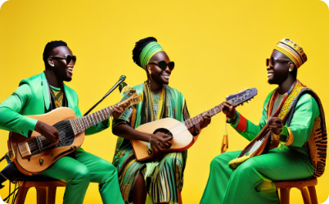
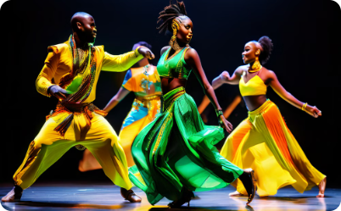
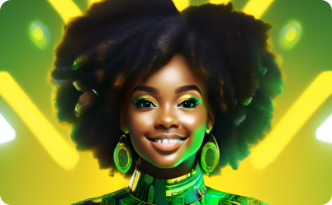
Celebrating the Richness of African Culture
Musical Diversity
Expressive Dance
Embracing the Future
The rich diversity of African music is a testament to the region's cultural wealth. From the rhythmic beats of drums to the soulful melodies of string instruments, African music reflects the unique histories, traditions, and identities of its people.
African dance is a powerful form of expression, conveying emotions, narratives, and cultural values through the language of the body. These dances are not merely performances but living embodiments of the community's spirit and heritage.
As African societies continue to evolve, the preservation and celebration of their rich cultural traditions, including music and dance, remain vital. These artistic expressions will continue to shape the identity, resilience, and aspirations of the African people, inspiring future generations.

Slide 10
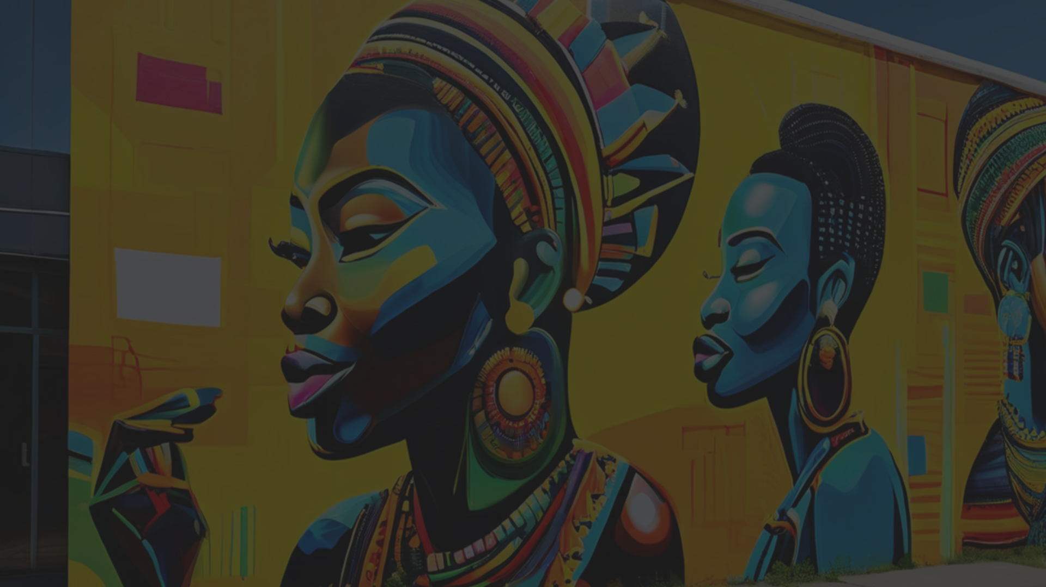



Conclusion: Honoring the Past, Embracing the Future
Preserving Cultural Treasures
African music and dance are not merely forms of entertainment, but rather vital cultural treasures that preserve the region's rich heritage, values, and collective memories. Their continued practice and evolution are essential for the survival and flourishing of African identity.
Empowering Women and Communities
The evolving role of women in African music, dance, and social movements has been a catalyst for transformation, challenging traditional gender norms and empowering marginalized communities. This progress towards greater equality and inclusion holds immense promise for the future of African societies.
Embracing the Transformative Power
As we celebrate the richness of African culture, we must also recognize the transformative power of its artistic expressions. Music, dance, and the ongoing dialogue around gender roles have the potential to foster social cohesion, promote cultural understanding, and inspire positive change across the continent and the world.

